Slide 1
ICE Proposal Wireframes
Version 1
9/6/2018

Slide 2
Purpose
Screen mockups to aid development ahead of an agile Scrum event
4 primary user types (see personas next slide)
Training portal

Slide 3
Personas
System Administrator
Full: Login, CRUD on users, skills, offices, supervisors
Special Agent
Limited: Login, alerts, view my training
Supervisor of Special Agent(s)
TBD (cmoulton)
Senior Leader (D4 and above)
TBD (cmoulton)

Slide 4
System Administrator Mockups

Slide 5
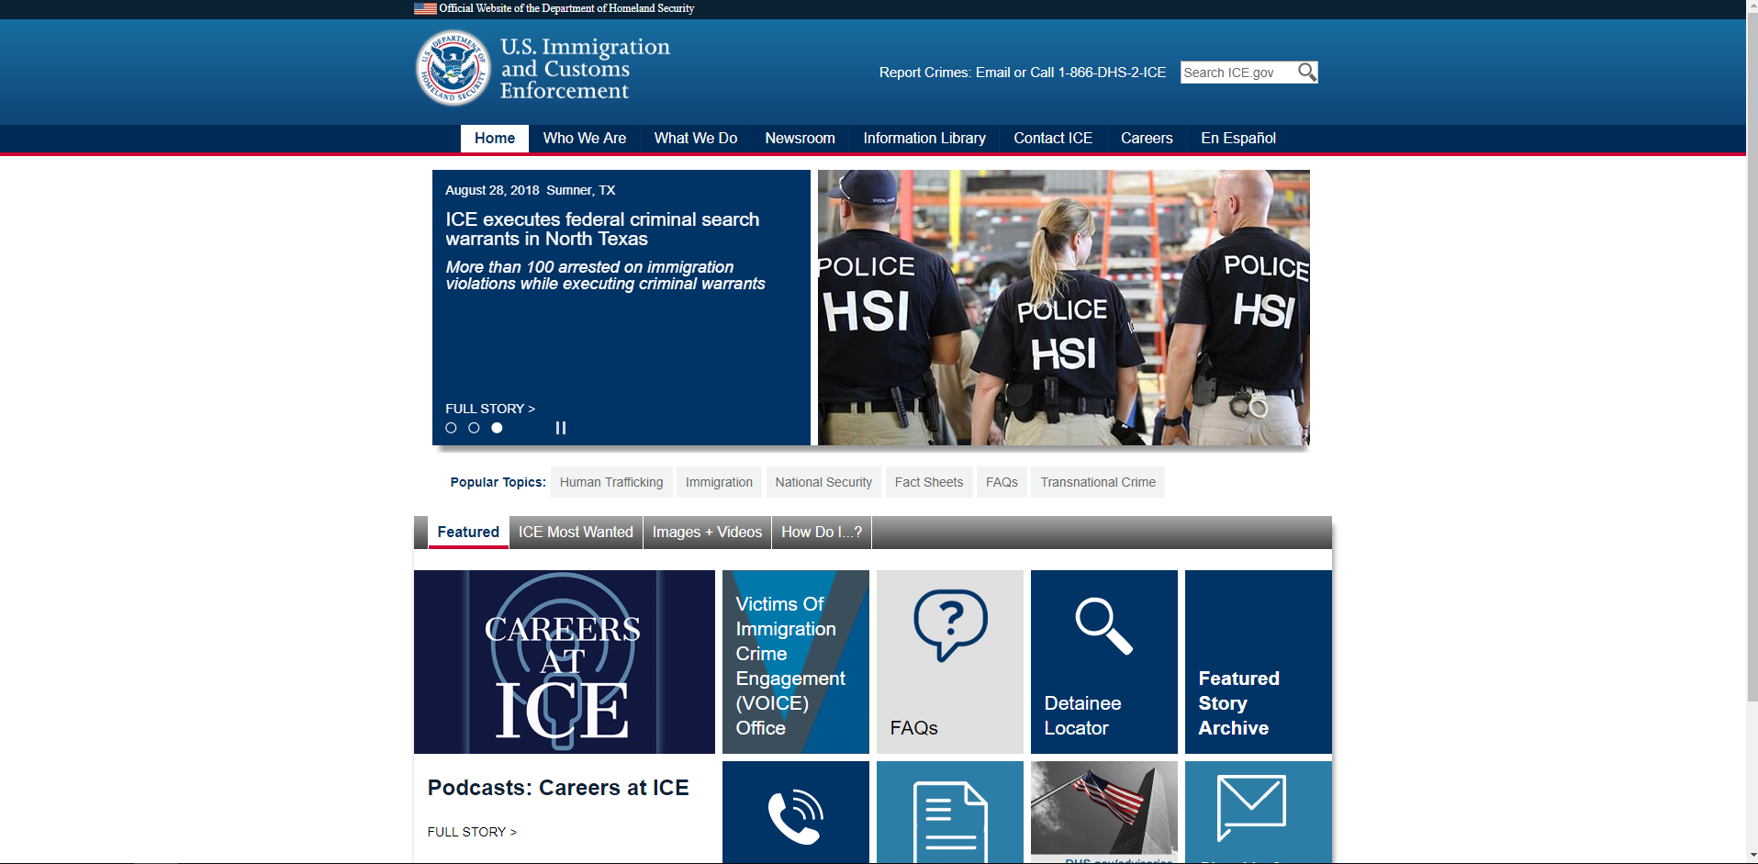
Shown Below is Login Screen for System Administrator
Training Portal
Homeland Security Investigations
Welcome to the ICE HSI Training Portal. Please log-in using your credentials below.
User ID
Password
I forgot my username or password
Login
After clicking Login button, then the Alert and Continue button Appear
ALERT:
Firearms quarterly report due by 8/30/2018.
Click Here to Run Report
Continue
Since no user story for this Alert box, the text is fixed and the Click Here button does nothing
Notes:
HSI badget

Slide 6
Shown Below is Login Screen for Special Agent
Training Portal
Homeland Security Investigations
Welcome to the ICE HSI Training Portal. Please log-in using your credentials below.
User ID
Password
I forgot my username or password
Login
ALERT:
Your firearms qualification must be completed within 3 days.
After clicking Login button, then the Alert and Continue button Appear
Request Training
Continue
Notes:
HSI badget

Slide 7
Shown Below is Login Screen for Supervisor Special Agent
Training Portal
Homeland Security Investigations
Welcome to the HSI ICE Training Portal. Please log-in using your credentials below.
User ID
Password
I forgot my username or password
Login
ALERT:
The following agents have proficiencies expiring soon:
Derick Smith, Firearms qualification due 8/21/18
Lia Mya, Firearms qualification due 8/22/18
Al Unser, Firearms qualification due 8/22/18
After clicking Login button, then the Alert and Continue button Appear
Continue

Slide 8
Shown Below is System Administrator: Destination After Login
Training Portal
Homeland Security Investigations
Agent Info
System Administration
New Agent
Existing Agent
* Mandatory Field
First Name
*
Allow dash in first or last name
Middle Initial
Role dropdown: System Owner, System Admin, Supervisory Special Agent, Special Agent
Last Name
*
Suffix
Role
*
Unique User ID
*
Office Code
*
*
Drop downs for office and location sorted alphabetically
Location
User’s Supervisor
*
Cancel
Save

Slide 9

Shown Below is System Administrator: Destination After Login, Update Existing User Info
Training Portal
Homeland Security Investigations
Agent Info
System Administration
New Agent
Existing Agent
Find Agent:
USERNAME FIRST NAME MIDDLE LAST
UserID X First Middle Last
UserID Y First Middle Last 4361
First Name
Middle Initial
1. Admin searches for name.
2. Admin chooses name in table
3. Text boxes here display current info for agent clicked on in step 3.
4. Admin can change any info and click “Save.”
Last Name
Suffix
Role
Unique User ID
Office Code
Location
User’s Supervisor
Cancel
Save

Slide 10
Shown Below is System Administrator: Destination After Login, Edit Skills or Training
Training Portal
Homeland Security Investigations
Agent Info
System Administration
Edit Skills or Training
Category | Type | Training | (M)andatory (D)iscretionary
Commercial License | Comm. Driver’s License | Comm. Driver’s Training | D
Commercial License | Pilot’s License | Comm. Pilot’s License | D
Language | Spanish | Spanish Training | D
Firearms | Glock 40 | Pistol Qual Course | M
+
-
Cancel
Save
Click “+” to add table row.
Click “-” to disable (not remove) row.
Or edit text in table directly.

Slide 11
Shown Below is Special Agent: Destination After Login, Viewing Dashboard
Training Portal
Homeland Security Investigations
Special Agent Dashboard
Request Training
My Training
Report Date Training Finished, with Documentation
Submit Degree Info with Documentation
Category | Type | Training | (M)andatory (D)iscretionary
Commercial License | Comm. Driver’s License | Comm. Driver’s Training | D
Commercial License | Pilot’s License | Comm. Pilot’s License | D
Language | Spanish | Spanish Training | D
Firearms | Glock 40 | Pistol Qual Course | M
My Expiring Certifications & Overdue Training
Category | Type | Training | (M)andatory (D)iscretionary
Commercial License | Comm. Driver’s License | Comm. Driver’s Training | D
Commercial License | Pilot’s License | Comm. Pilot’s License | D
Language | Spanish | Spanish Training | D
Firearms | Glock 40 | Pistol Qual Course | M

Slide 12
After Clicking “Report Date Training Finished”
Training Portal
Homeland Security Investigations
Special Agent Dashboard
Request Training
Report Date of Mandatory or Discretionary Training Finished with Documentation:
* Mandatory Field
Date Finished:
MM
DD
YYYY
*
Training Completed:
*
Upload scanned copy of training certificate, diploma, etc.
*
Cancel
Save
Notes:
We saw no reason to distinguish mandatory training from discretionary, so we folded user story 25 into this screen.

Slide 13
After Clicking “Report Date Training Finished”
Training Portal
Homeland Security Investigations
Special Agent Dashboard
Request Training
Submit Degree Info:
* Mandatory Field
Date Finished:
MM
DD
YYYY
*
Degree Earned:
*
Upload scanned copy of diploma
*
Cancel
Save

Slide 14
Shown Below is Special Agent: Requesting Training
Training Portal
Homeland Security Investigations
Request Training
Special Agent Dashboard
My Training Request
* Mandatory Field
Training Event
*
Training Type
Cost
*
Date Requested
MM
DD
YYYY
Preferred School or Training Institution
*
Cancel
Save

